Slide 1


MCSC0009:
Image Processing And Analysis
Elements of Visual Perception

Slide 2

However, the choice of technique is often based on subjective, visual judgment
DIP
Mathematical | Probabilistic
Formulations
Hence, understanding Human Visual Perception VERY IMPORTANT !!!
The best vision model we have!
Knowledge of how images form in the eye can help us with processing digital images

Slide 3
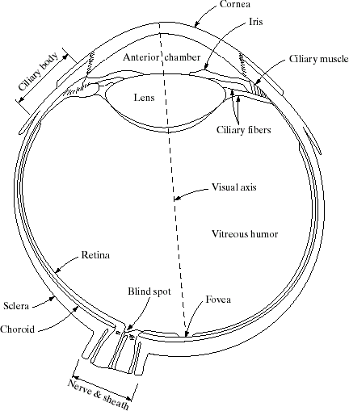
Structure (anatomy) of the human eye
Avg diameter : 20mm
3 membranes enclose the eye
Cornea & sclera
Choroid
Retina

Slide 4
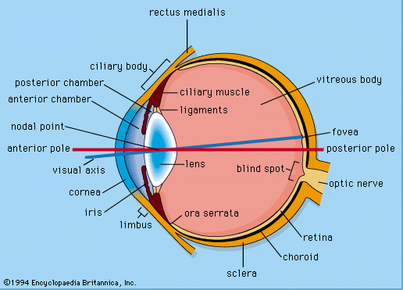

Slide 5
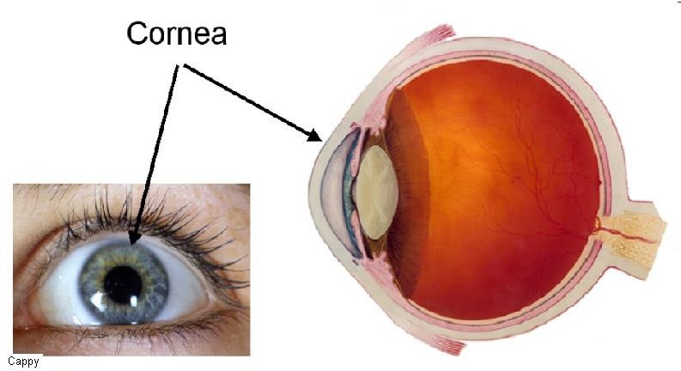
Structure of the human eye …
Cornea
Tough & Transparent tissue
Covers the frontal surface of the eye

Slide 6
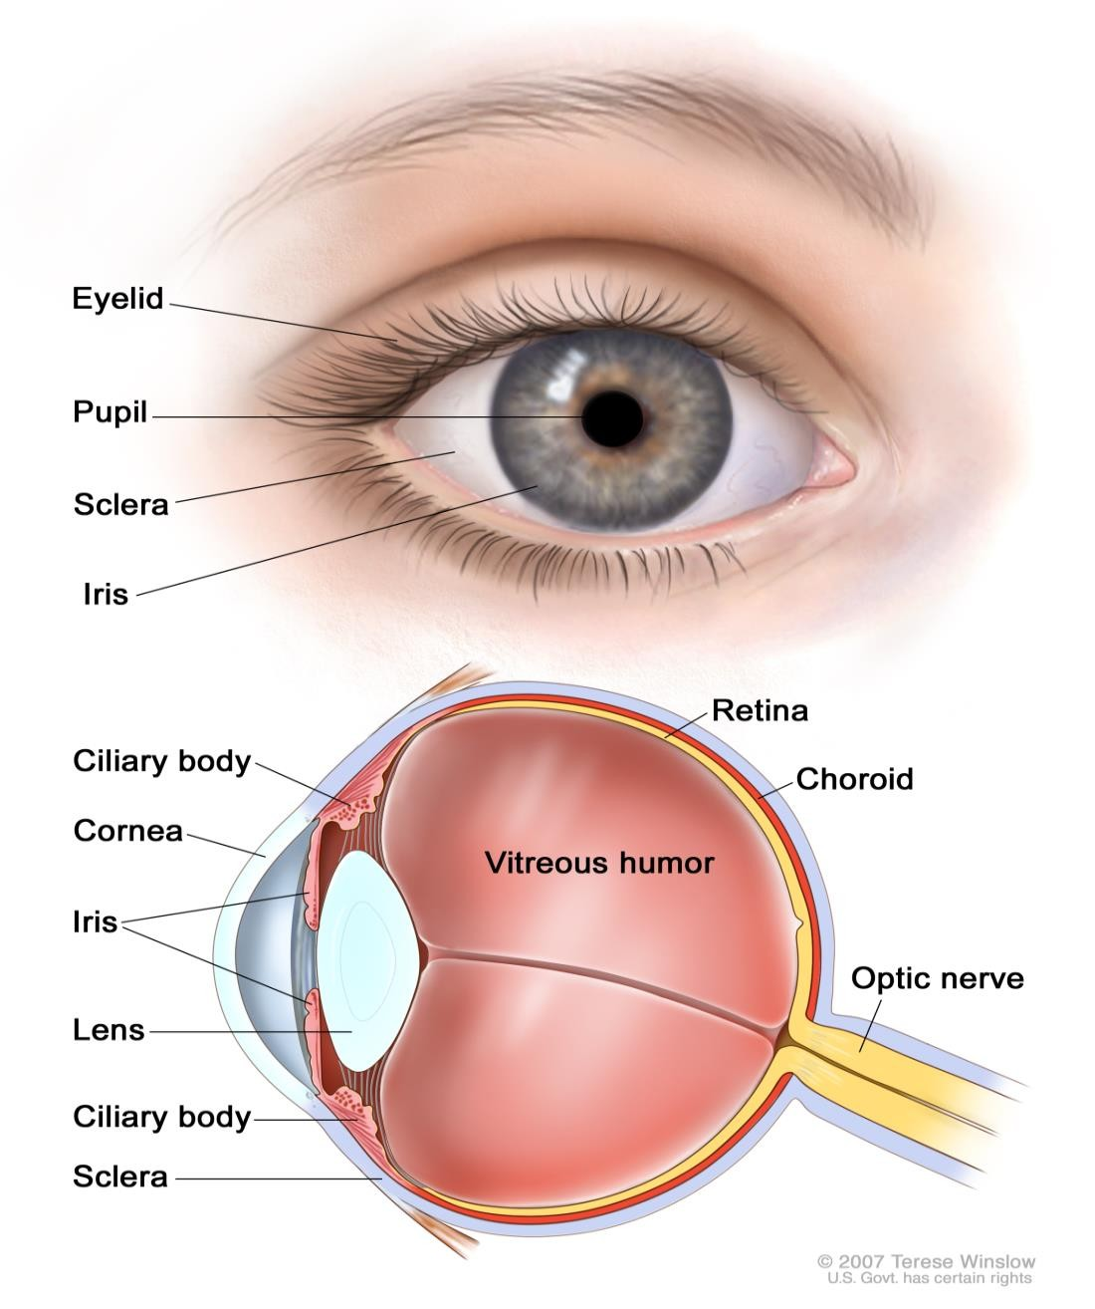
Structure of the human eye …
Sclera
Continuous with cornea
Opaque membrane
Encloses the remainder of the optic globe

Slide 7
Structure of the human eye …
Choroid
🞑 The choroid contains blood vessels for eye nutrition and is heavily pigmented to reduce extraneous light entrance and backscatter.
🞑 It is divided into the ciliary body and the iris diaphragm, which controls the amount of light that enters the pupil (2 mm ~ 8 mm).
The lens is made up of fibrous cells and is suspended by fibers that attach it to the ciliary body.
It is slightly yellow and absorbs approx. 8% of the visible light spectrum.

Slide 8
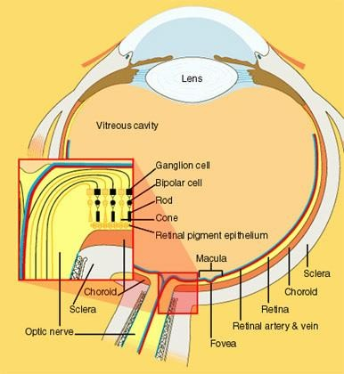
Structure of the human eye …
Retina
Light from an object is imaged on the retina
The retina lines the entire
posterior portion.
Discrete light receptors are distributed over the surface of the retina:
cones (6-7 million per eye) and
rods (75-150 million per eye)

Slide 9
Structure of the human eye …
Cones
Cones provide color vision and respond to higher levels of illumination
The density of the cones is higher in the fovea
Each one is connected to its own nerve end.
Cone vision is called photopic (or bright-light vision).
Muscles controlling the eye rotate the eye ball until the image of an object of interest falls on the fovea.

Slide 10
Structure of the human eye …
Rods
Rods are distributed over the retinal surface
Rods give a general, overall picture of the field of view and are not involved in color vision.
Rods are important for black and white vision in dim light
Discriminate between different shades of darks and light
Rods provide visual response called Scotopic Vision
Objects seen by moon light appear as colourless forms because only rods are stimulated.

Slide 11
Blind-Spot Experiment
⦿ Draw an image similar to that below on a piece of paper (the dot and cross are about 6 inches apart)
⦿ Close your right eye and focus on the cross with your left eye
⦿ Hold the image about 20 inches away from your face and move it slowly towards you
⦿ The dot should disappear!

Slide 12
Image Formation in the Eye
The eye lens (as compared to an optical lens) is flexible.
It gets controlled by the fibers of the ciliary body and to focus on distant objects it gets flatter (and vice versa).
Distance between the center of the lens and the retina (focal length):
varies from 17 mm to 14 mm (refractive power of lens goes from minimum to maximum).
Objects farther than 3 m use minimum refractive lens powers (Focal Length 17 mm) and vice versa.

Slide 13
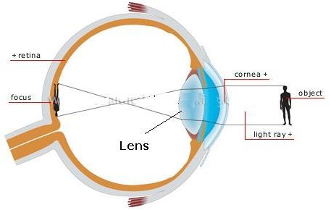
Image Formation in the Eye

Slide 14
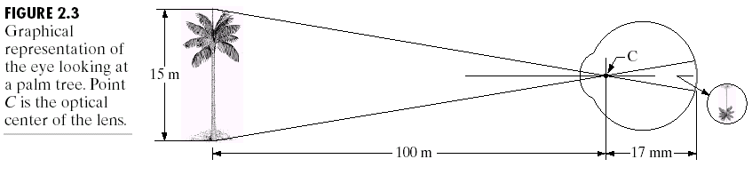
15 / 100 = h / 17
h = 2.55 mm
Size of retinal image (h)
Retinal image reflected primarily in the fovea
Perception takes place by relative excitation of light receptors
Receptors transform radiant energy into electrical impulses which are decoded by the brain

Slide 15


Brightness Adaptation & Discrimination
Range of light intensity levels to which human visual system (HVS) can adapt
of the order of 10¹⁰
Glare
Scotopic threshold
Limit
Subjective brightness (i.e. intensity as perceived by the HVS) is a logarithmic function of the light intensity incident on the eye.

Slide 16
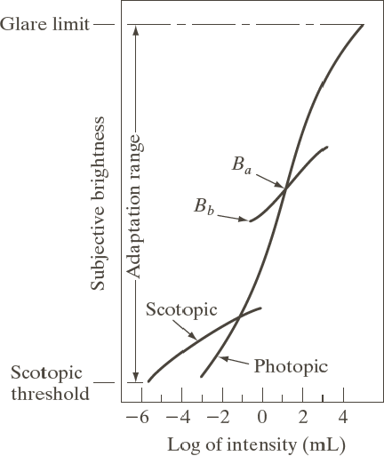
Visual Phenomena: Brightness adaptation
The subjective brightness of human visual system has an impressive dynamic range.
Cannot accomplish this range simultaneously

Slide 17


Visual Phenomena: Brightness adaptation
The HVS accomplishes this wide variation by changes in its overall sensitivity.
Brightness Adaptation Level
For any given set of conditions, the current sensitivity level of HVS

Slide 18
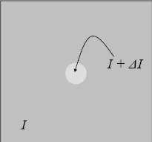
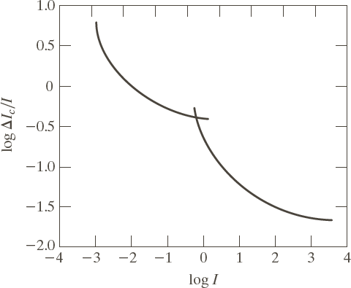
Brightness discrimination
Weber ratio (the experiment) ΔI_{c}/I
I: the background illumination
ΔI_{c} : the increment of illumination
Small Weber ratio indicates good discrimination
Larger Weber ratio indicates poor discrimination

Slide 19
Psychovisual effects
The perceived brightness is not a simple function of intensity
🞑 Mach band pattern
The visual system tends to undershoot or overshoot around
the boundary of regions of different intensities
🞑 Simultaneous contrast
A region’s perceived brightness does not depend simply on its intensity.
🞑 Optical illusion
Eye fills in nonexisting information or wrongly perceives geometrical properties of objects

Slide 20

Psychovisual effects : Mach band pattern
The Mach band effect is illustrated in the figure above.
The intensity is uniform over the width of each bar.
However, the visual appearance is that each strip is darker at its right side than its left.

Slide 21

Psychovisual effects :Simultaneous contrast
The simultaneous contrast phenomenon is illustrated above.
The small squares in each image are the same intensity.
Because of the different background intensities, the small squares do not appear equally bright.

Slide 22
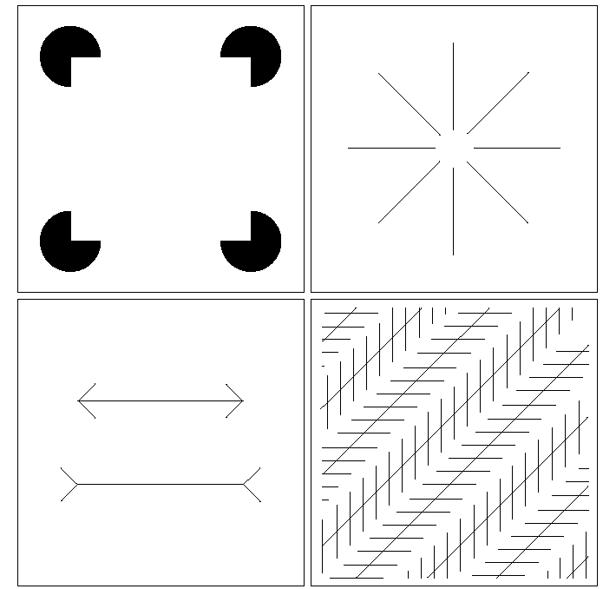
Psychovisual effects :Optical illusion
Eye fills in non existing information or wrongly perceives geometrical properties of an object

Slide 23


Psychovisual effects :Optical illusion …

Slide 24
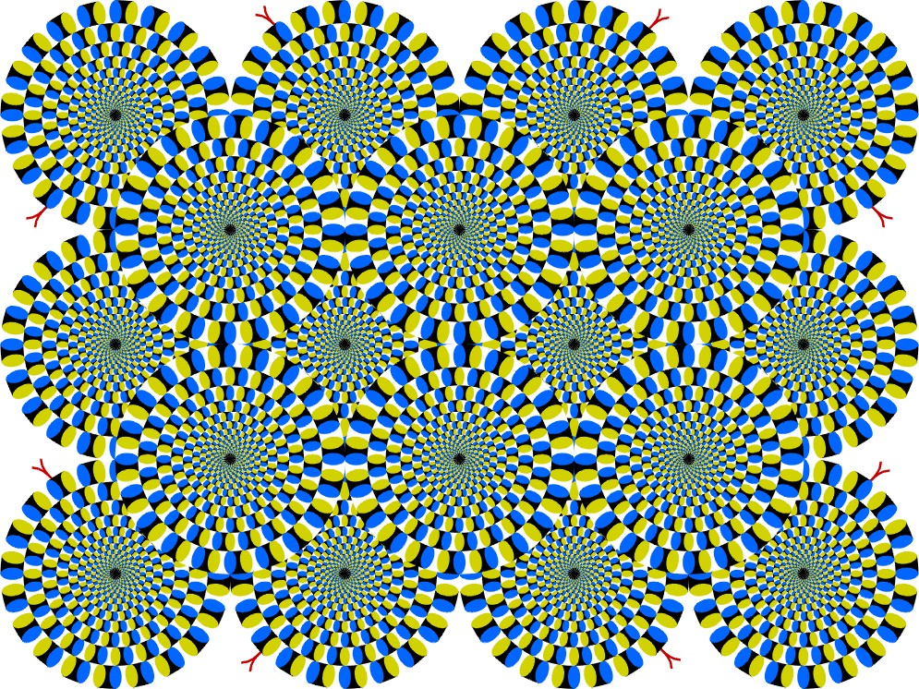
Psychovisual effects :Optical illusion …

Slide 25

Psychovisual effects :Optical illusion …

Slide 26
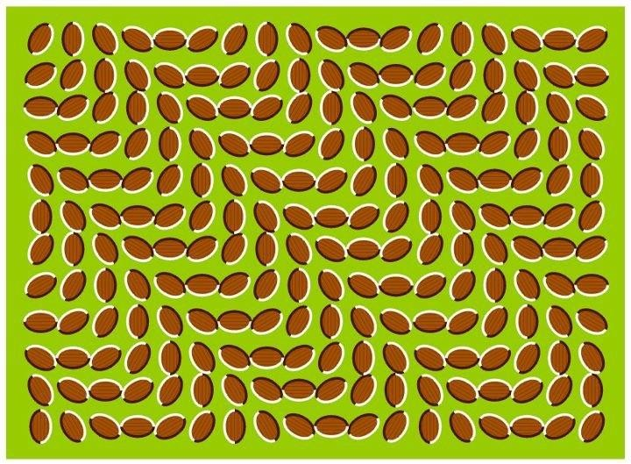
Psychovisual effects :Optical illusion …

Slide 27
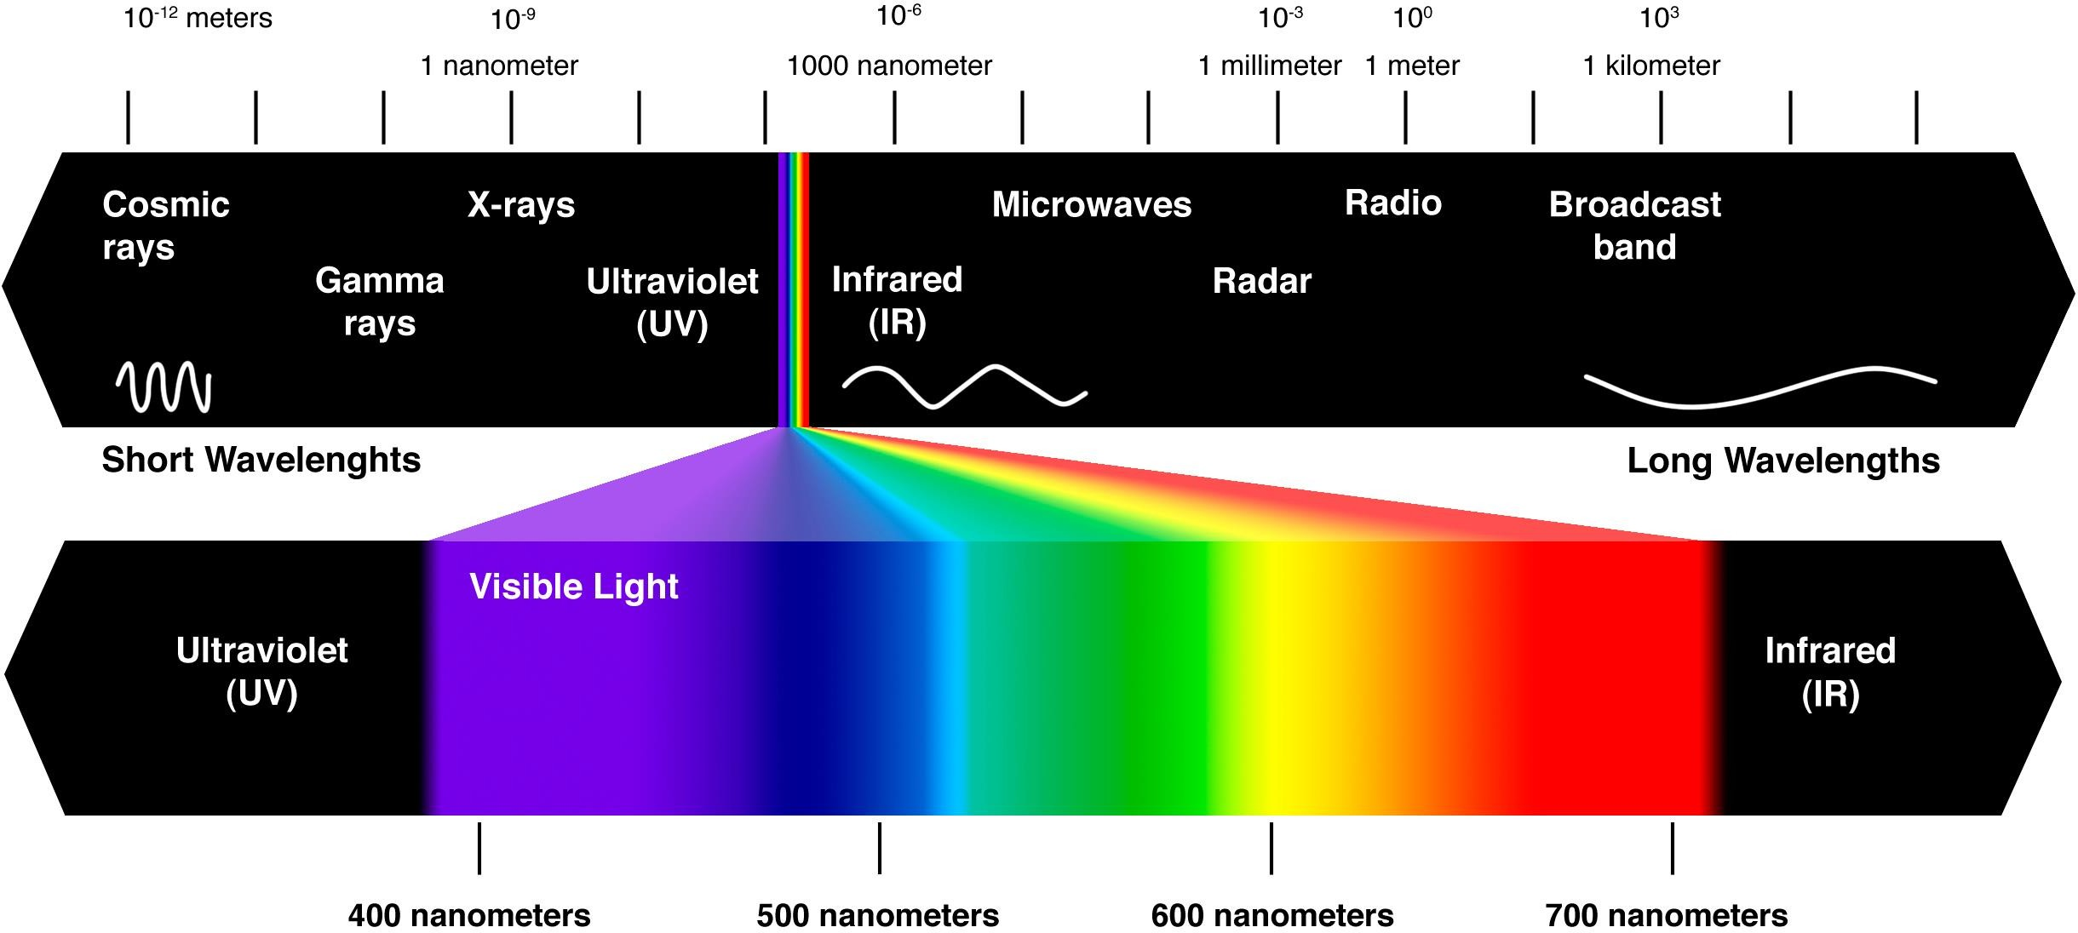
Electromagnetic spectrum

Slide 28
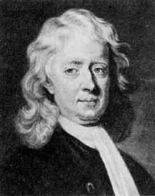
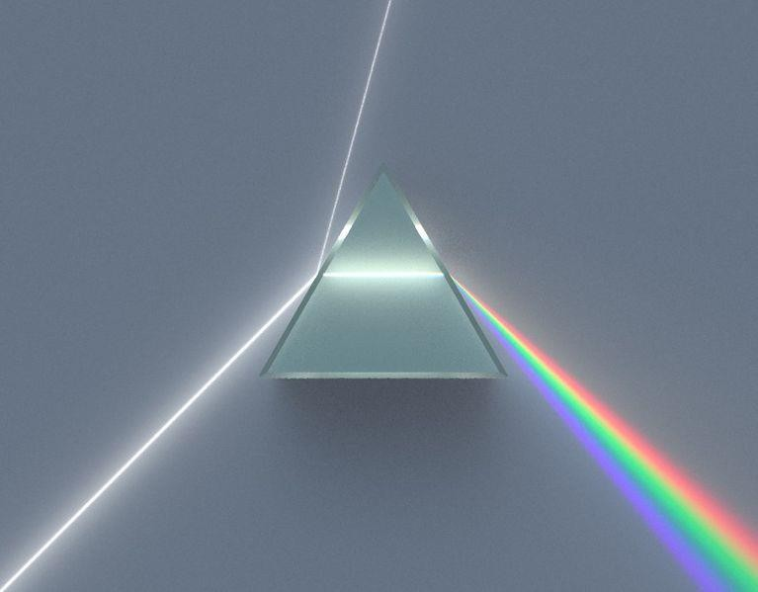
Spectrum of Colors
Sir Isaac Newton

Slide 29
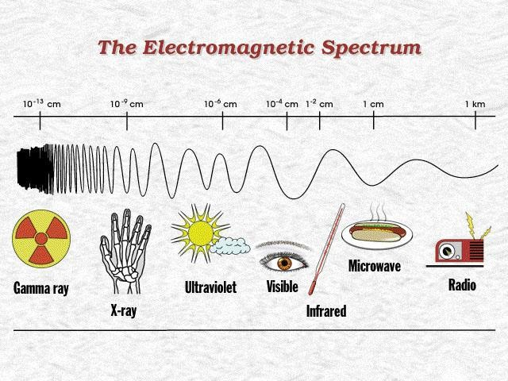

Slide 30
Electromagnetic spectrum
Speed = frequency x wavelength
λ = c/ν
i.e
Speed of light is 3 x 10⁸ m/sec.
The energy E, of the various components of the electromagnetic spectrum is given as:
E = h ν
where h is Planck’s constant

Slide 31
Chromatic Light
Radiance
Total amount of energy that flows from the light source
Measured in Watts (W)
Luminance
Measures the amount of energy an observer perceives from a light source.
Measured in lumens (lm)
Brightness
Subjective descriptor – practically impossible to measure.
It embodies the notion of intensity.
Key factor in describing colour sensation.

Slide 32

Any Questions ?

